Slide 1
The Antivirus: Tr0n3
By ++Void
A mini Metroidvania, with a focus on speed running

Slide 2
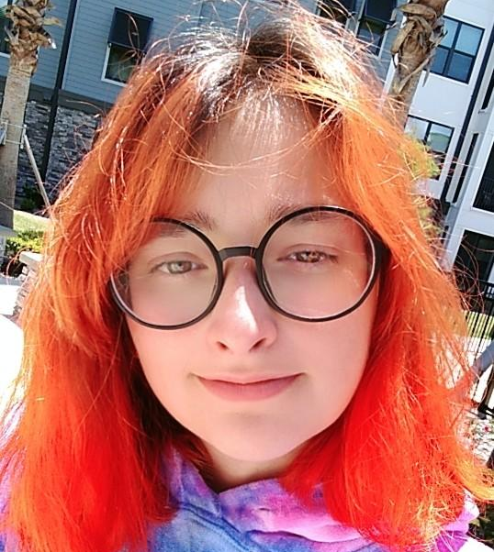
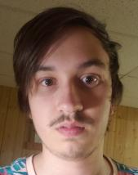

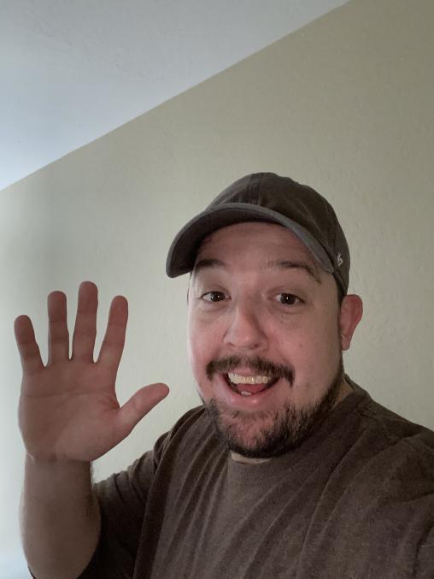

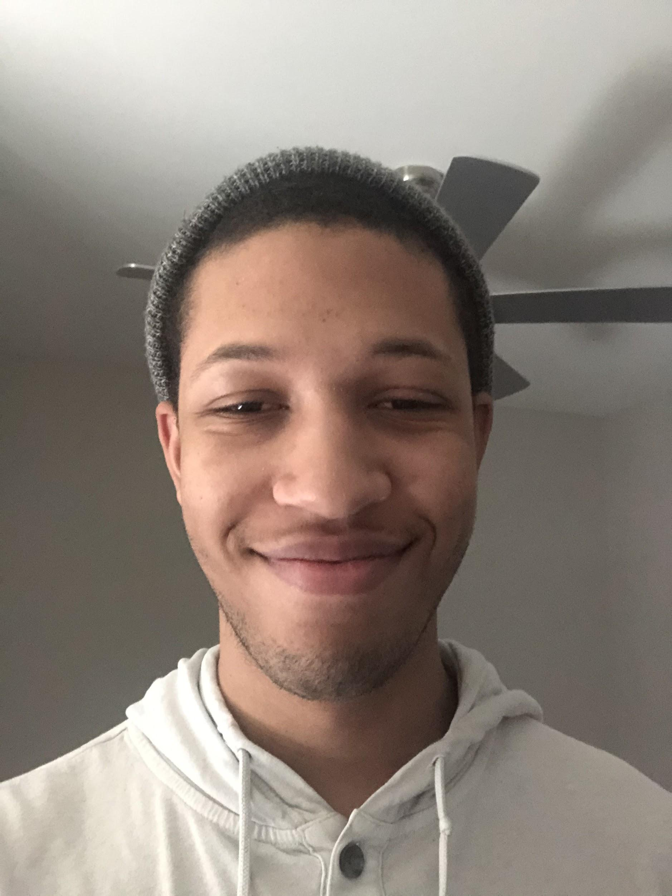
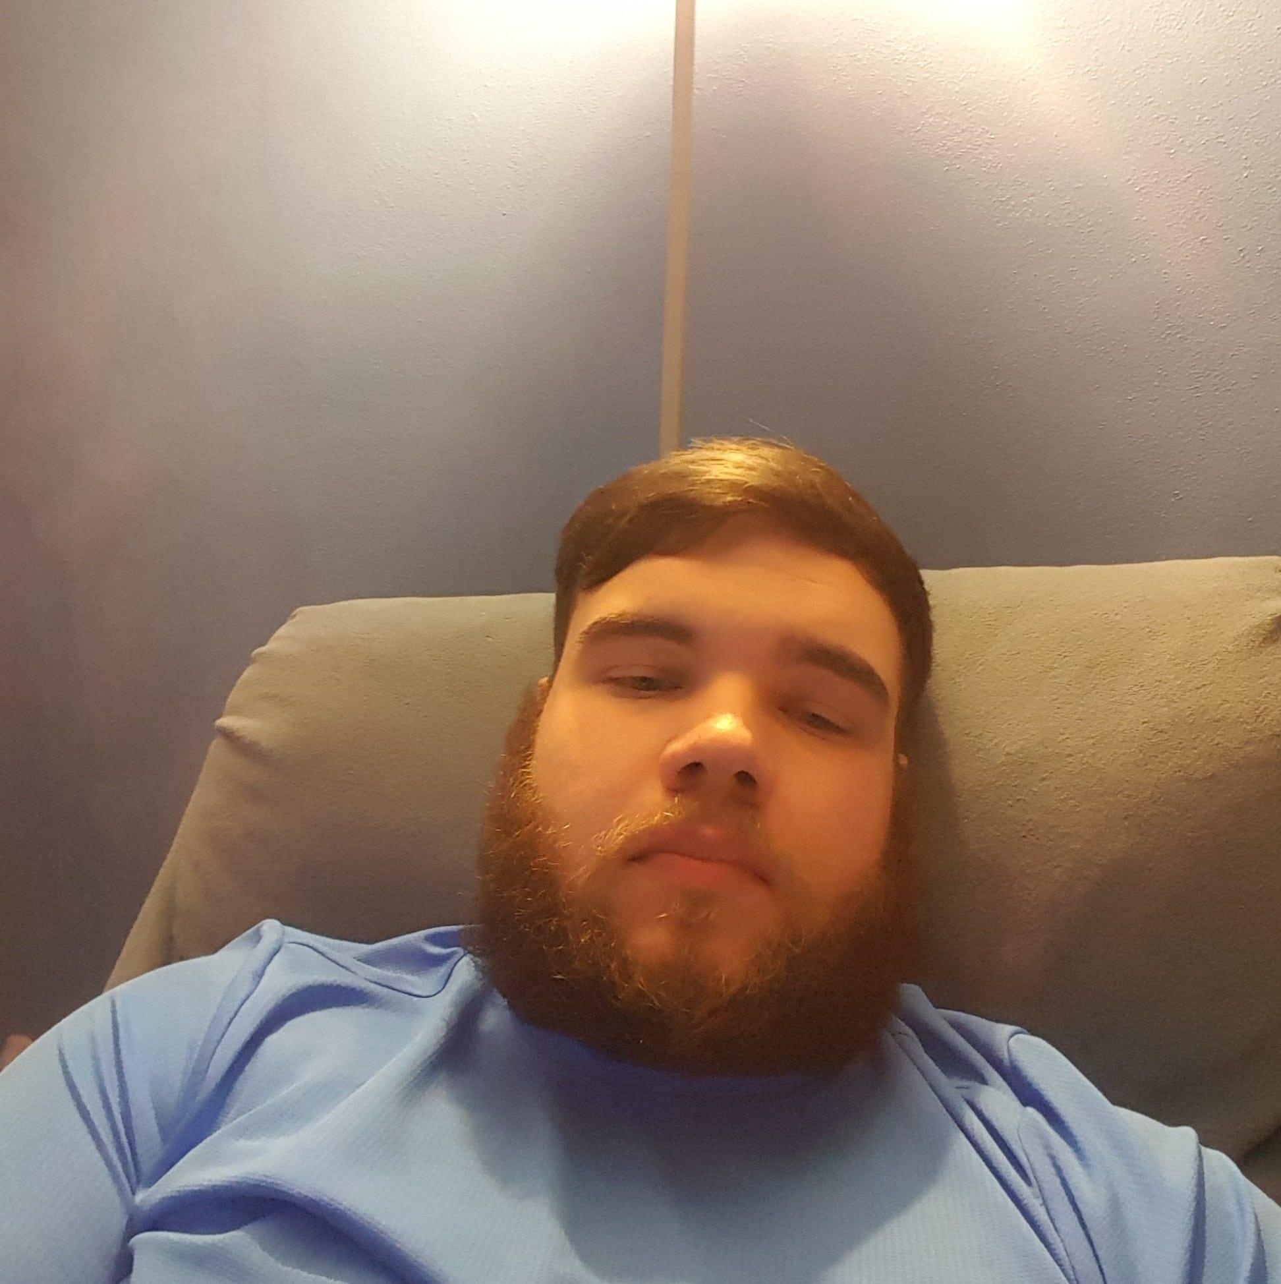
++Void
- Amara Gitomer -
Enemy Art, UI
- Kurtis McCammon -
Room Handling, Object Management
- Josh Packard -
Sound Design
- Justin DaSilva -
Player Programmer
- Steven Lee -
Sound Programmer, Music Composer, Environment Art
- Michael Binney -
Enemy Programmer, Environment Programmer
Notes:
Add team photo later or individual photos

Slide 3
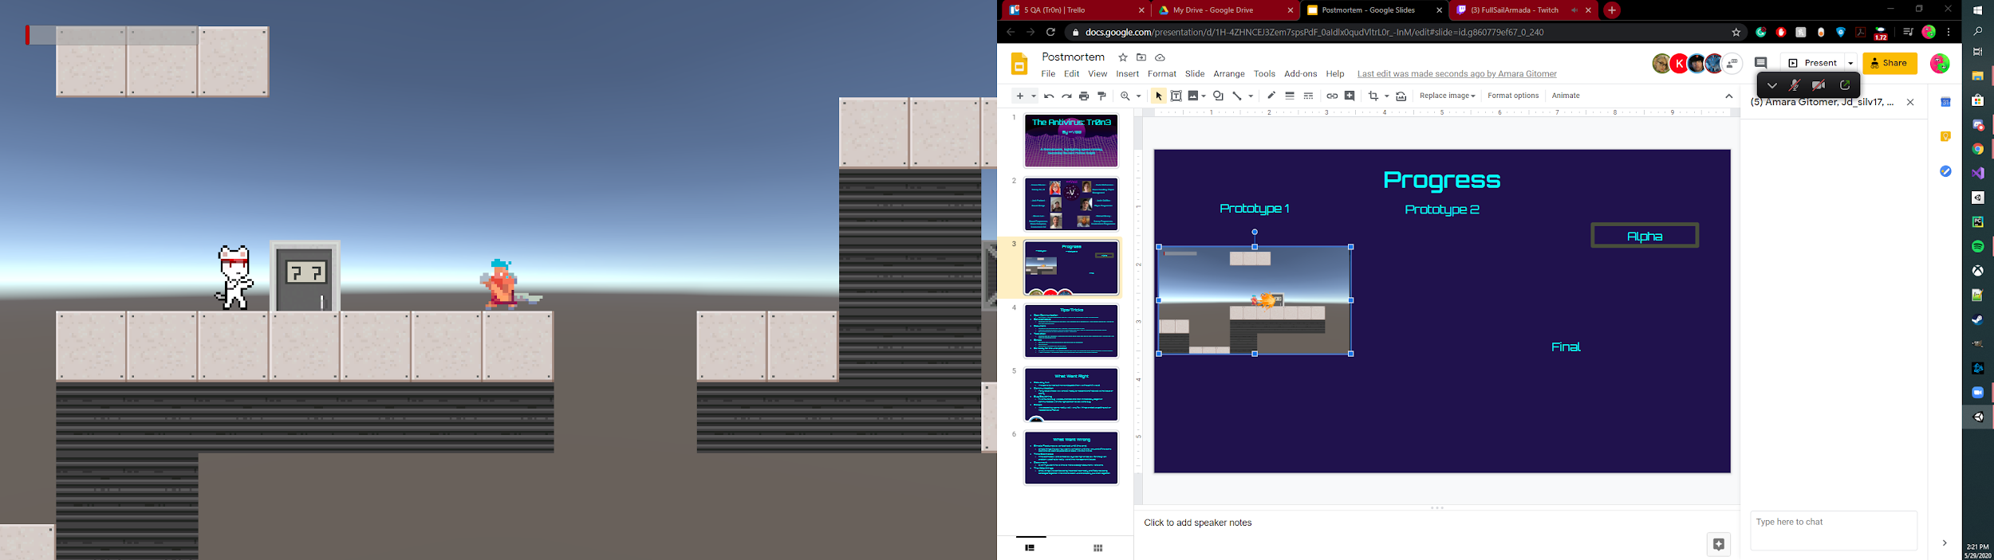
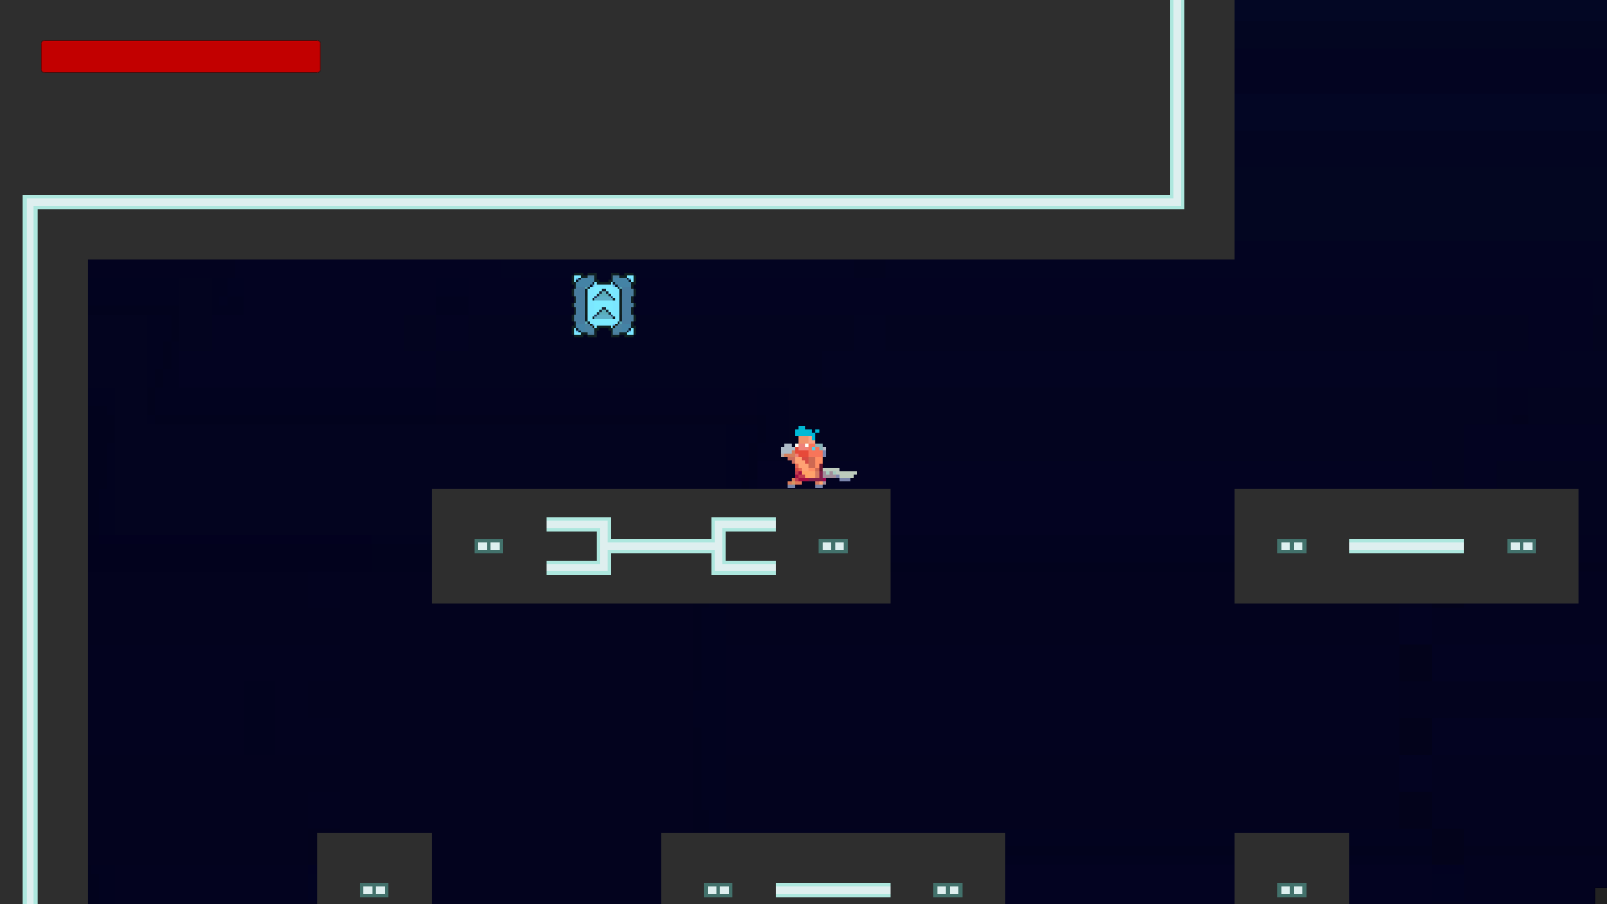
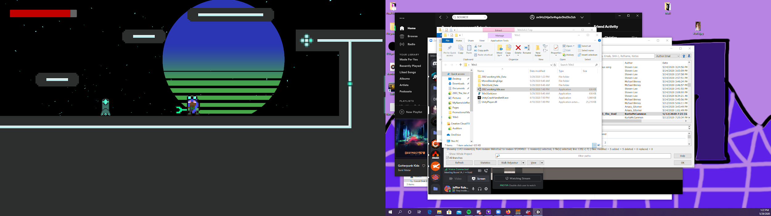
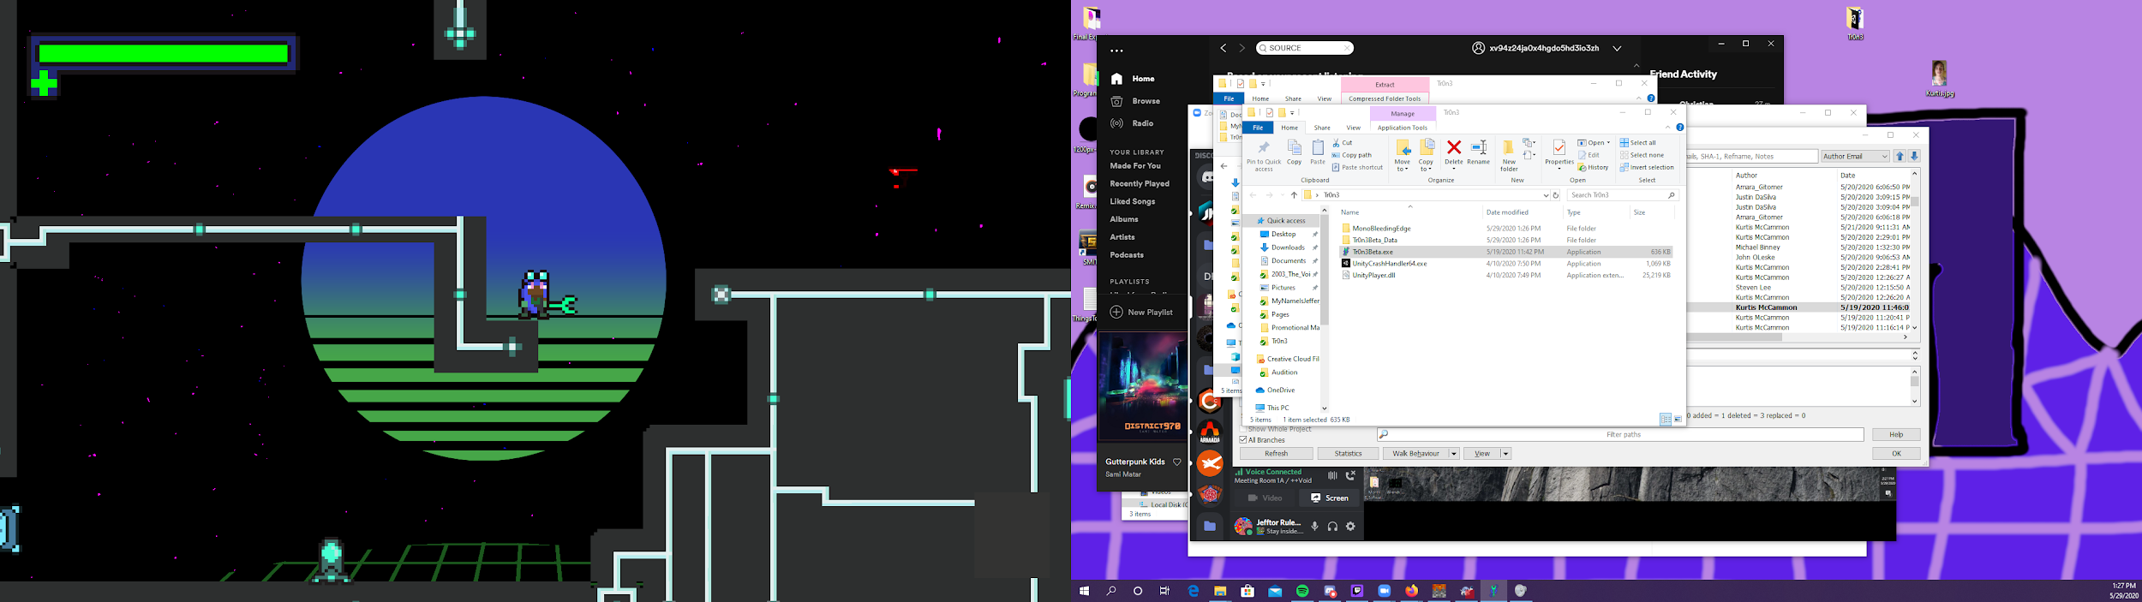
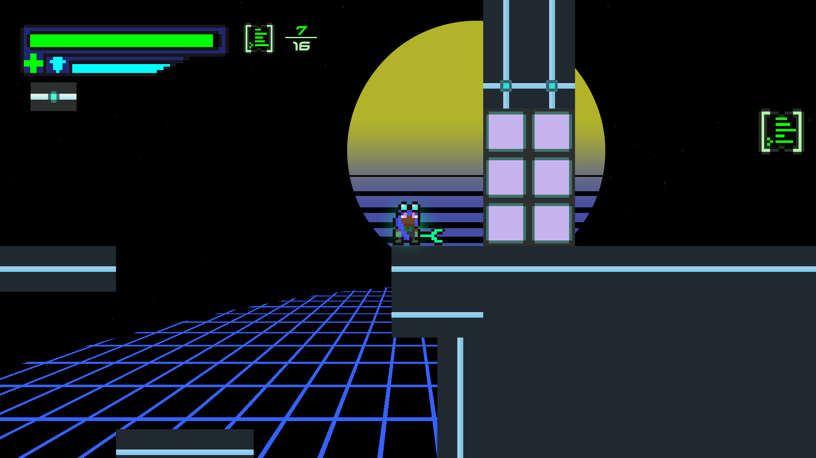
Progress
Prototype 1
Prototype 2
Alpha
Beta
Final

Slide 4
Tips/Tricks
Open Communication
Talk often with your teammates and be willing to ask questions or answer questions.
Set a schedule
Agreeing on a set schedule to not only work together but a schedule of when people should be working so you can communicate.
Document
Document the features and the way you want your game to play.
It makes it easier to decide what fits in your game and allow you to understand your game better.
Take screenshots of your process to show progress.
Test often
Creates and environment where you can catch more bugs and test to see if features are working the way they are supposed to be.
Be ready for the unexpected
Be ready to be merged with random people and to have to suddenly make major changes to your project.
When/If merged with another team don’t restart just take one of the teams projects.
Stress
Put more time in at the beginning so you don’t end up crunching
Take breaks
Pain is just weakness leaving the body
General Unity things
Use classes
Be Aware of Time.timescale
Use event systems. They may be scary, but they will save you headaches.
Encapsulate
Inheritance is good. Use it a lot.
Don’t be afraid to use multiple scripts on one object.
Use serialized fields. They make it easy to debug, and are simple to remove.
Use GetComponent<T> over serialized field.

Slide 5
What Went Right
Actually fun
The game turned out more enjoyable than we thought it would.
Communication
If any issue arose we were all ready to respond and help solve the issue or clarify.
Bug Squishing
If we found a bug we documented and then immediately began or communicated with the right person to solve the bug.
Scope
We scoped our game really well. Very few things ended up getting cut, or needed be buffed up.

Slide 6
What Went Wrong
Simple Features overlooked until the end.
Simple things like saving wasn’t worked on until the very end of the alpha. Start this as soon as possible or code with this in mind.
Time Estimates
Time estimates were almost always too high or too low for the given problem. Leading to really weird time management issues.
Document
Even if you don’t have time to make a design document. Make one.
The little things.
Small things like sprites being imported incorrectly and features being bandaged together. Find time to clean up and properly put them together.

